Slide 1



Analysis and Prediction on Online Shopper intention at E-commerce Website
Sena Vietrin Sanidya
senavietrin

Slide 2
Content
Item 1
Background
Item 2
Objective
Item 3
Data Introduction
Item 4
Exploratory Data Analysis
Item 5
Model Building
Item 6
Business Recomendation

Slide 3
Background
In order to enhance marketing and boost income in the upcoming year, Company X plans to examine consumer activity patterns on their e-commerce website and their effect on revenue. Additionally, businesses require a model that accurately forecasts whether a user has the ability to boost revenue or not.
Notes:
<a href="https://storyset.com/design">Design illustrations by Storyset</a>

Slide 4

OBJECTIVE !
Get insights into visitor intention from duration, Page visit, and Conversion toward revenue
Build model to predict visitor behaviour towards revenue using classification method
Develop business recommendations to increase revenue from visitor sessions

Slide 5
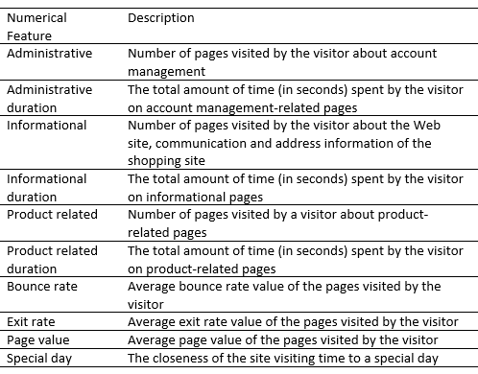
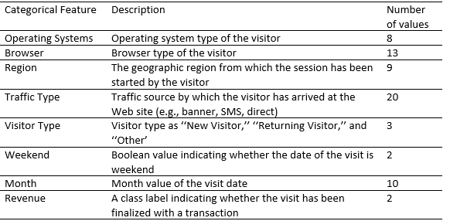
Data Introduction
Historical data of visitors’ sessions at an e-commerce website, The dataset was formed so that each session would belong to a different user in a 1-year period to avoid any tendency to a specific campaign, special day, user profile, or period.
Source : https://archive.ics.uci.edu/ml/datasets/Online+Shoppers+Purchasing+Intention+Dataset

Slide 6
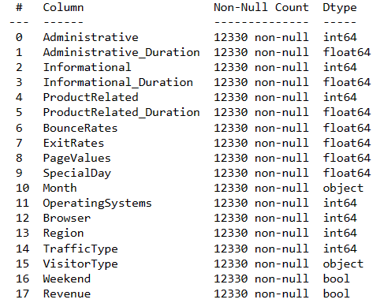
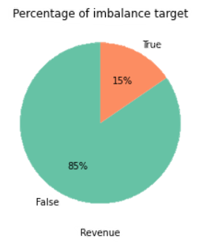


Data target extremely imbalance where the revenue or conversion visitors only 15% among 12330 visitors
No missing value, data types are fine
Dropped 125 duplicates rows
Notes:
Photo by Joseph Gonzalez on Unsplash

Slide 7
Exploratory Data Analysis

Slide 8
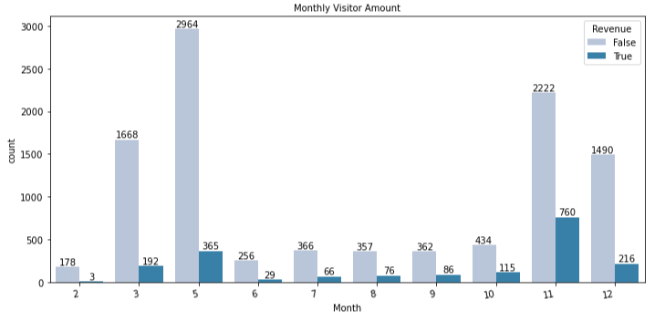
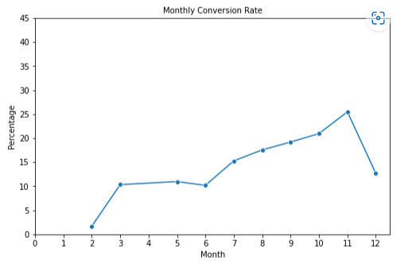
Monthly Conversion
Although May sees the most visitors, November sees the highest conversion rate (25%)
Conversions significantly increased between February - March and June - November, but they sharply decreased in December
Visitation information for February and April is unavailable.

Slide 9
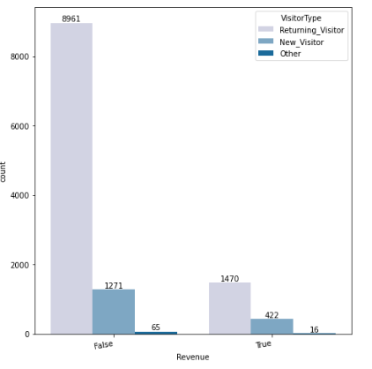
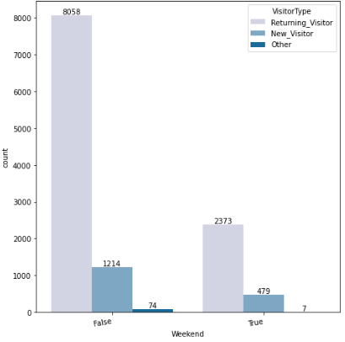
Visitor’s Type
There are more returning visitors than new ones, indicating that existing users are still interested in visiting the website.
Compared to returning visitors, who only make revenue in the amount of 14%, new visitors have better conversion rates, with 25% of new visitors generating income.
Weekday visits are higher than weekend visits among users.

Slide 10
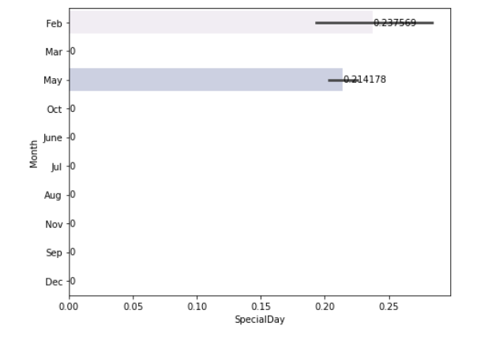
Purchases Close To The Special Day
Purchases made on special days only occur in May and February, which suggests that the special day was not utilized to its full potential. So that an effort can be made to encourage clients to make purchases and offer discounts on special days in the form of a special day campaign.

Slide 11
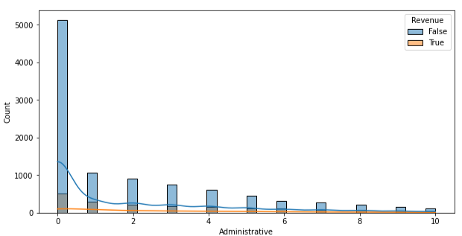
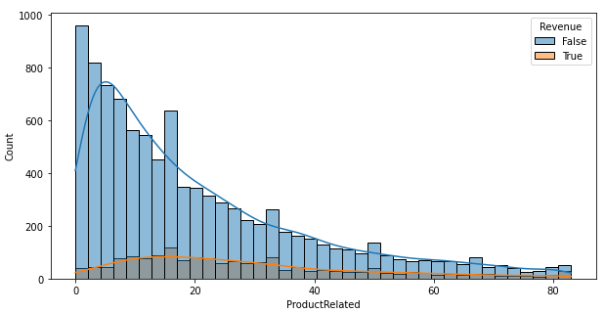
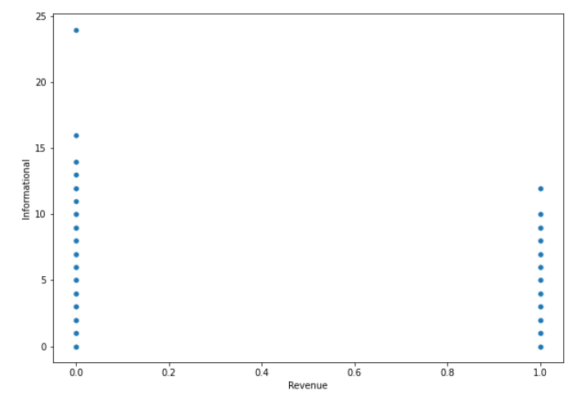
Number of Visits Per Page By Visitor
Administrative page: the number of visits in a single session might range from 0 to 10. The median estimate yields two visits each session for visitors that generate revenue.
Page relating to the product: The number of visits each session ranges from 0 and 80. The median number of visits to revenue-generating visitors is 24 visits each session.
Informational page: the page that is rarely seen by both revenue and non-revenue users. Based on the median number of visits for users with and without revenue, there are 0 visits.
In general, revenue users have fewer visits per page than non-revenue users.
Notes:
<a href="https://storyset.com/design">Design illustrations by Storyset</a>

Slide 12
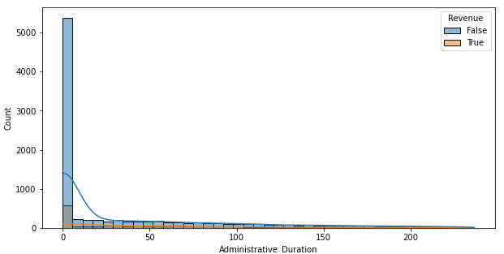
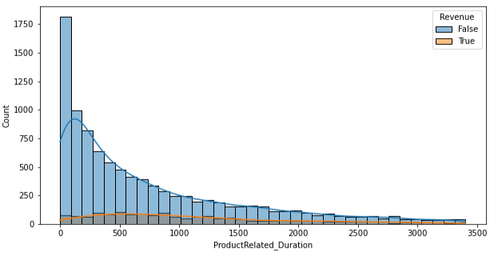
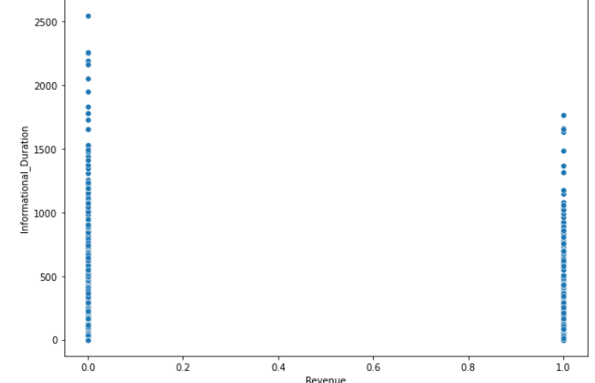
Duration Of Visitor Visits Per Page
Administrative: the median duration of visits by visitors with revenue is 34 seconds per session. Visitors with revenue spend less time, according to distribution.
Product-related: the median duration of visits by visitors with revenue is 15 minutes for each session. Visitors with revenue spend less time, according to distribution.
Informational: Based on the median duration for users with and without revenue on this page, users with revenue have a shorter duration than users without revenue.
The duration of a user's visit with revenue is shorter than the duration of a user's visit without revenue.
Notes:
<a href="https://storyset.com/design">Design illustrations by Storyset</a>

Slide 13
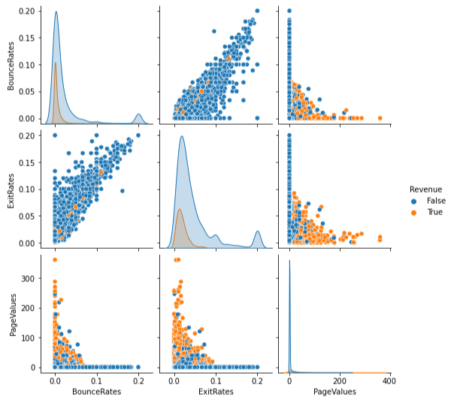
Page Value (PV) , Bounce Rate (BR) , and Exit Rate (ER)
PV: the average page value held by the user; a high page value implies that the page contributes significantly to income but does not show the number of pages visited. Because the number of visits and the value of a page are two distinct metrics
BR: the percentage of people that leave a website after only seeing one page. The bounce rate might show the level of visitor involvement as well as the interest or relevance of the initial page visited.
ER: the percentage of people that leave a website after visiting a specific page as the final page before leaving.
According to the Pearson correlation, BR and ER are significantly associated (0.9), while Page value has the highest correlation to Revenue of any parameter (0.49).
Notes:
Page Value dihitung dengan membagi total nilai transaksi atau pendapatan yang dihasilkan dari halaman tertentu dengan jumlah kunjungan ke halaman tersebut. Jadi, nilai Page Value tinggi menunjukkan bahwa halaman tersebut memberikan kontribusi yang signifikan terhadap hasil bisnis Anda, tetapi tidak memberikan informasi tentang jumlah halaman yang dikunjungi oleh pengguna.
Sebagai contoh, jika ada halaman tunggal yang memiliki tingkat konversi yang tinggi, dengan pengguna yang langsung melakukan pembelian atau mengisi formulir pada halaman tersebut, maka Page Value untuk halaman tersebut bisa tinggi, meskipun pengguna hanya mengunjungi halaman tersebut tanpa melanjutkan ke halaman lain.Sebaliknya, pengguna yang mengunjungi banyak halaman tanpa melakukan tindakan konversi atau menghasilkan pendapatan mungkin tidak memberikan nilai Page Value yang tinggi
jadi, penting untuk membedakan antara Page Value (kontribusi nilai halaman tertentu) dengan metrik lain seperti jumlah halaman yang dikunjungi oleh pengguna. Keduanya adalah metrik yang berbeda dan masing-masing memberikan wawasan yang berbeda terkait dengan perilaku pengguna dan kontribusinya terhadap hasil bisnis Anda.

Slide 14
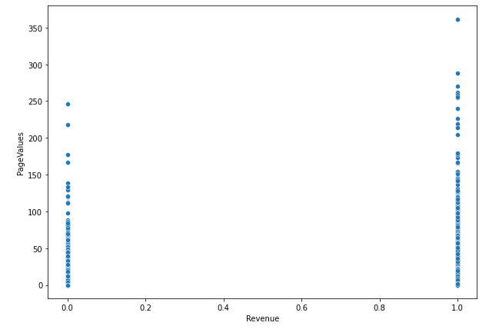
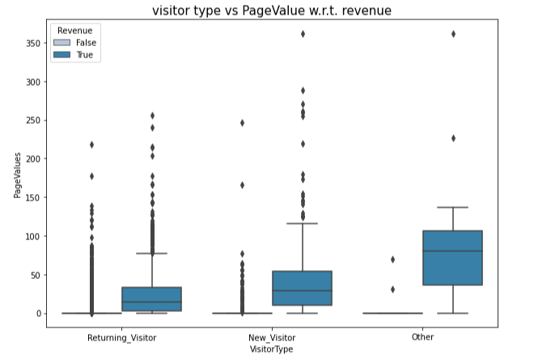
Visitor’s type VS Page Value
Observation :
Because of their high page value and income, new visitors have the potential to create conversions.
New visitors may have a specific interest to make a purchase. They have no prior experience with websites, but they may be influenced by a promotion or special deal that urges them to make a purchase.
Notes:
<a href="https://storyset.com/design">Design illustrations by Storyset</a>

Slide 15
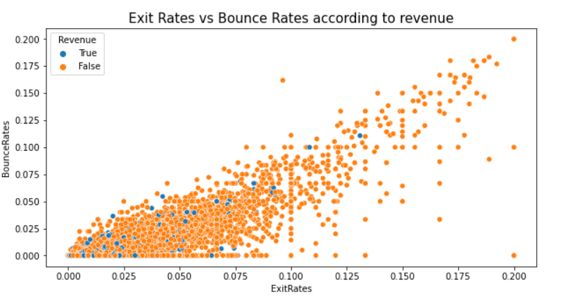
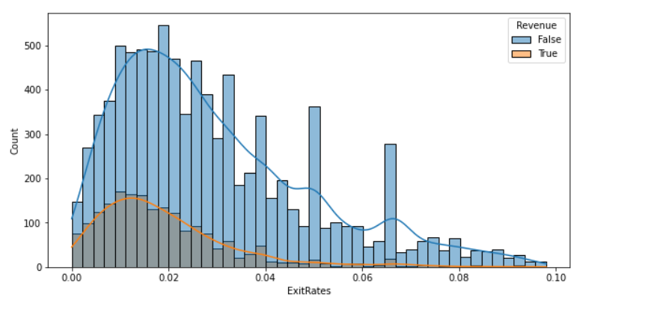
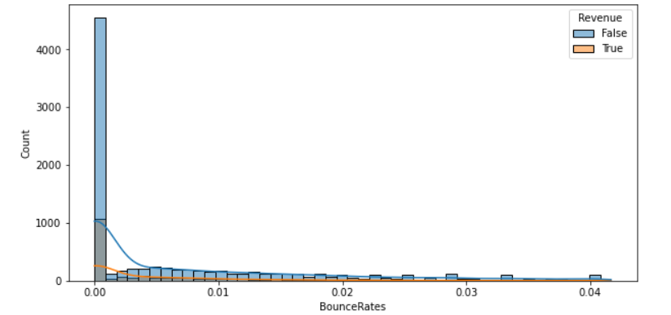
Visitor’s Bounce Rate (BR) and Exit Rate (ER)
“Visitors who experience high BR are also more likely to have high ER.”
Insight: many users leave after only visiting one page (bounce), and that page is also the last page before visitors leave the website (exit). In the context of web analytics, this can be interpreted as an indication of a problem or an area in which the user experience should be improved.
from the median we can find the threshold of BR = 0 and ER = 0.015909 when the value is higher than the treshold, visitors tend to not purchase
Notes:
<a href="https://storyset.com/design">Design illustrations by Storyset</a>

Slide 16
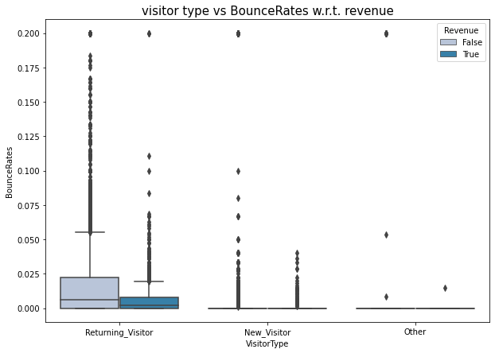
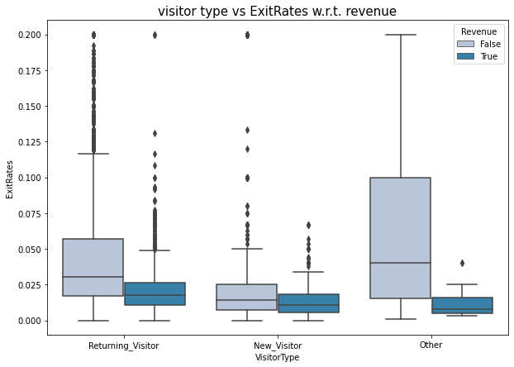
Bounce Rate (BR) and Exit Rate (ER) according to Visitor Type
Returning visitors are more likely to have abandoned their journey because they have the greatest BR and ER.
It is preferable to analyze the e-commerce website's content and user experience so that the company does not miss out on conversion possibilities from recurring visitors.
Notes:
<a href="https://storyset.com/design">Design illustrations by Storyset</a>

Slide 17
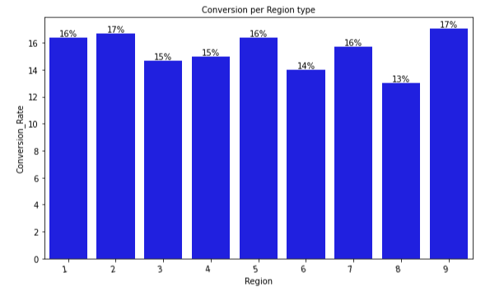
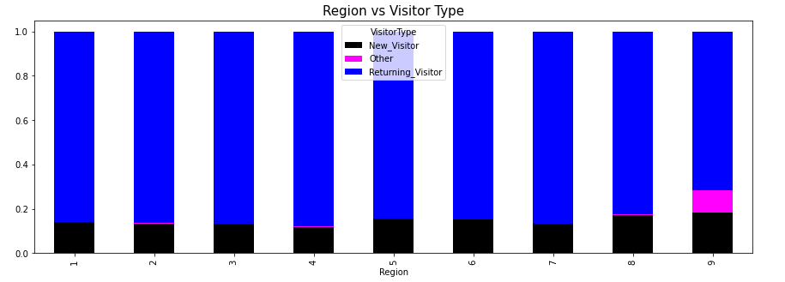
User’s Region Type
Users come from nine different regions, with the highest conversion rates in regions 2 and 9, which are dominated by around 80% retruning visitors.
Notes:
<a href="https://storyset.com/design">Design illustrations by Storyset</a>

Slide 18
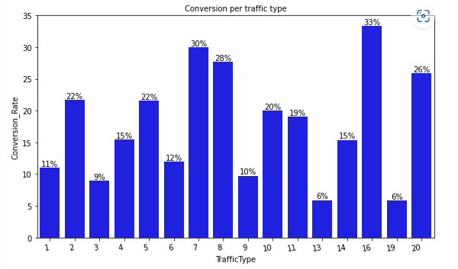
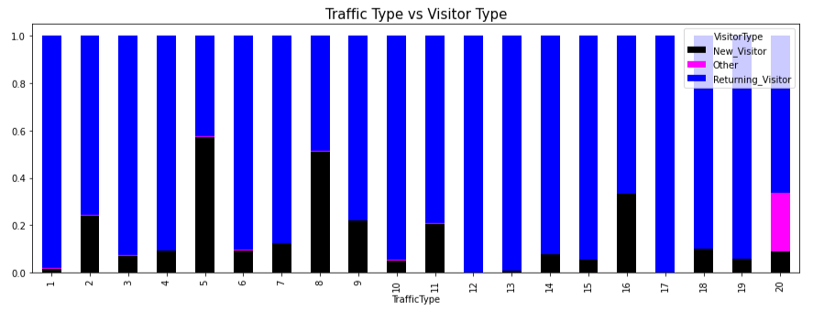
User’s Traffic Type
There are 20 traffic types used by users, where the highest conversions are on traffic 16 and traffic 7 which is dominated by returning visitors
Notes:
<a href="https://storyset.com/design">Design illustrations by Storyset</a>

Slide 19
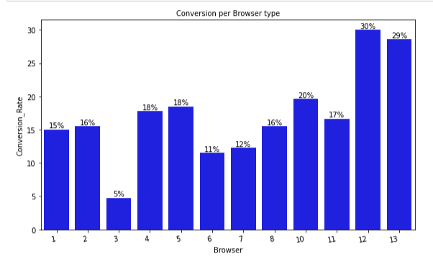
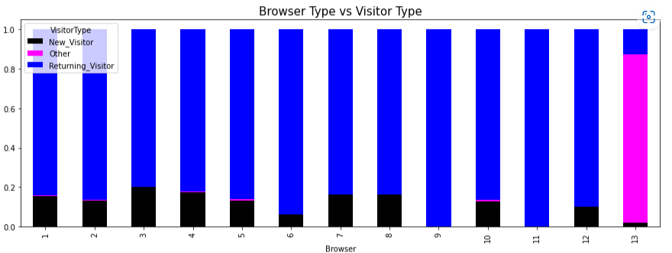
User’s Browser Type
Users utilize 13 different types of browsers, with types 12 and 13 having the highest conversion rates. Type 12 is predominately used by returning visitors, while type 13 is predominately used by visitors who are unsure whether they are existing or new users.
Notes:
<a href="https://storyset.com/design">Design illustrations by Storyset</a>

Slide 20
Model Building
Modeling is done with a classification method to predict which customers create revenue and which do not generate revenue based on their behavior on an e-commerce website.
1. Simple Pre-Processing
2. Baseline model
3. EDA + Feature engineering
4. Improved model
Best Model
5. Hypertuning paramter
Notes:
<a href="https://storyset.com/design">Design illustrations by Storyset</a>

Slide 21
Feature engineering
1
2
3
LABEL ENCODING FOR BINARY FEATURES
Scaling
Frequent Encoding
Perform standar scaling for all numerical features
Each features would have mean of 0 and standard deviation is 1
Operating System
Browser
Region
Traffic Type
Month
Visitor Type
Revenue ( True = 1, False = 0)
Weekend (True =1, False = 0)

Slide 22
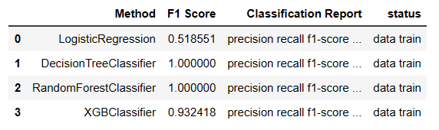
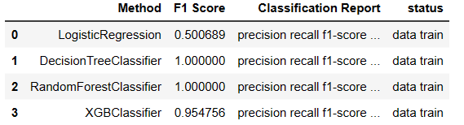
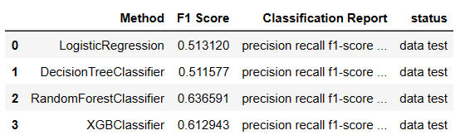
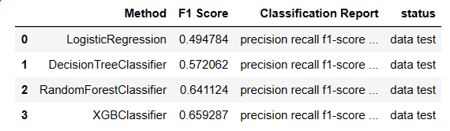
Base line
Improved model
Following multiple feature engineering trials, the evaluation metric value (F1 score) of the baseline model increased. The XGBoostClassifier afterwards underwent hyperparameter tunning to produce a model with the best parameters and the best performance.
Notes:
<a href="https://storyset.com/design">Design illustrations by Storyset</a>

Slide 23
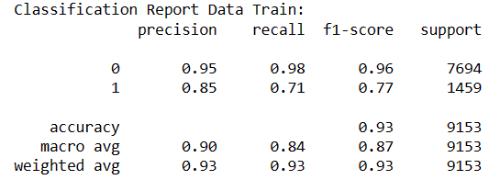
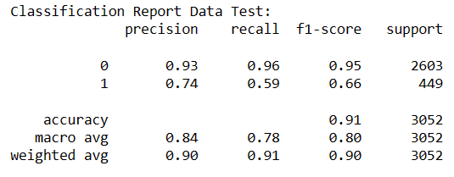
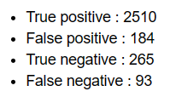
Best Model : XGBosst Classifier
Confusion matrix
Because the performance between the train data and the test data has an acceptable difference of 11% on the F1 score, the model performance is better than it was previously.
F1: The model's accuracy and recall (the ability to correctly identify users who are really generating revenue) are both 66%.
Notes:
<a href="https://storyset.com/design">Design illustrations by Storyset</a>

Slide 24
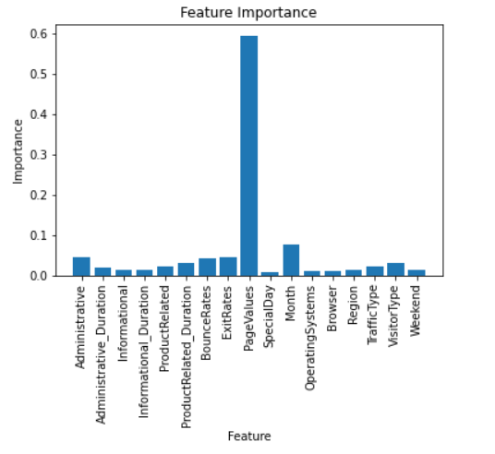
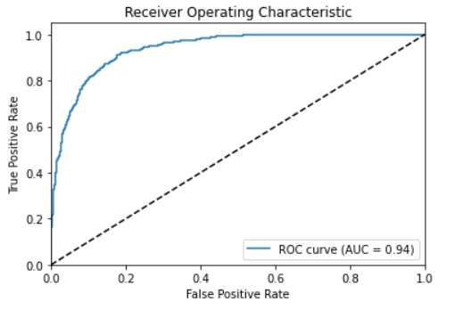
Best Model : XGBosst Classifier
The model's ability to differentiate between users with and without revenue is quite good, with AUC = 0.94.
When compared to other features in the XGBoost Classifier model, page value is the most influential.
Notes:
<a href="https://storyset.com/design">Design illustrations by Storyset</a>

Slide 25
SUMMARRY
November saw the greatest conversion rate (25%).
Users tend to shop around holidays in February and May compared to special days in other months.
Users who successfully make a purchase or generate revenue typically visit and stay on pages for shorter periods of time than users who do not.
Due to their higher page value and income, new visitors have the potential to provide better conversions.
Returning visitors often only browse one page before leaving the website.
Regions 2 and 9 have the highest conversion rates, which are primarily made up of returning visitors.
The highest conversion rates are found in traffics 16 and 7, which are primarily made up of returning visitors.
The two browsers with the highest conversion rates are 12 and 13, with browser 12 dominated by returning visitors and browser 13 by other users.
Best Model is XGBoostClassifier with f1 score 66%

Slide 26
Business Recomendation
Because consumers frequently encounter high bounce rates and departure rates, companies must assess the content and user experience of their websites.
By running campaigns that capitalize on the month's holidays and related product highlights, monthly conversions can be raised.
Because returning visitor conversions are still lower than those of new visitors, they must be raised. This can be achieved by using points-based rewards and product suggestions that are relevant to user searches.
provides customers from low-conversion regions with lower shipping cost
adjusting the user experience to the user's preferred browser
Notes:
<a href="https://storyset.com/design">Design illustrations by Storyset</a>

Slide 27
Thank you !

